Slide 1

Serverless Deep Neural Network(DNN) with Azure Functions and ML.Net
Praveen Raghuvanshi
@praveenraghuvan
https://bit.ly/3vIiMlD

Slide 2



Introduction
Cloud Architect @ Harman, A Samsung Company
Domain: Professional Audio, Video & Control
Area of Expertise: Cloud, Distributed computing
Area of Interest: AI/ML and IoT
Location: Bangalore, India
Member:
https://bit.ly/3vIiMlD

Slide 3
Agenda
Serverless
Azure Functions
Deep Neural Networks(DNN)
Image Classification
ML.Net
Demo
https://bit.ly/3vIiMlD
@praveenraghuvan

Slide 4
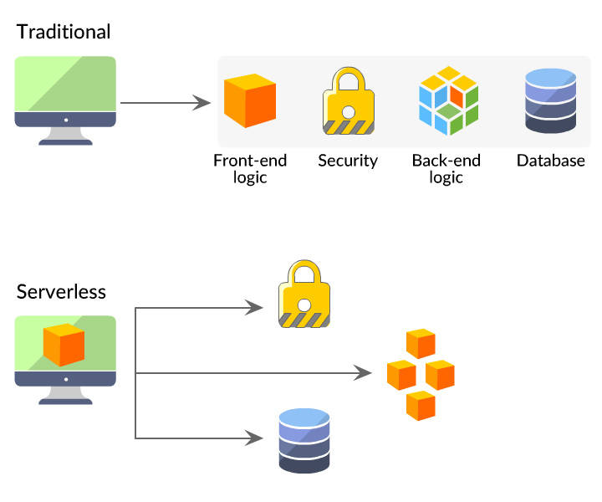
Serverless
source: https://danielhkim.net/2020/02/27/serverless-cloud-computing/
https://bit.ly/3vIiMlD
@praveenraghuvan

Slide 5
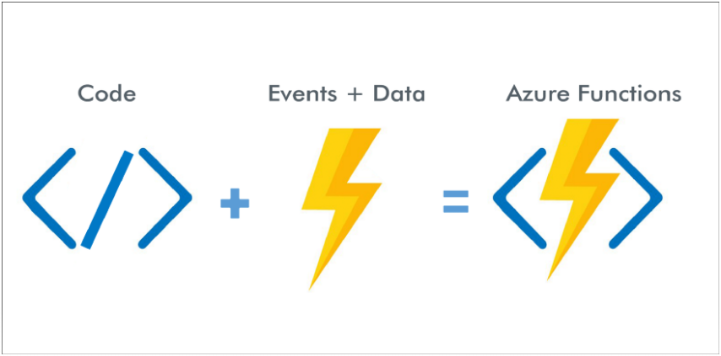
Azure Functions
https://bit.ly/3vIiMlD

Slide 6
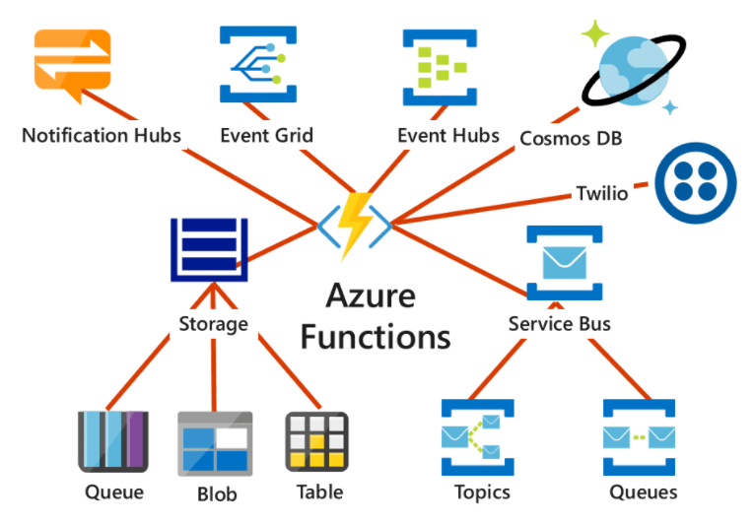
Azure Functions
https://bit.ly/3vIiMlD

Slide 7
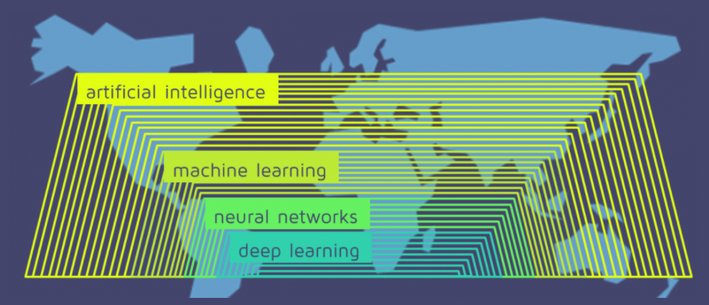
Deep Neural Network
source: https://quantdare.com/what-is-the-difference-between-deep-learning-and-machine-learning/
https://bit.ly/3vIiMlD
Notes:
AI involves a computer executing a task a human could do.
Machine learning involves the computer learning from its experience and making decisions based on the information.

Slide 8
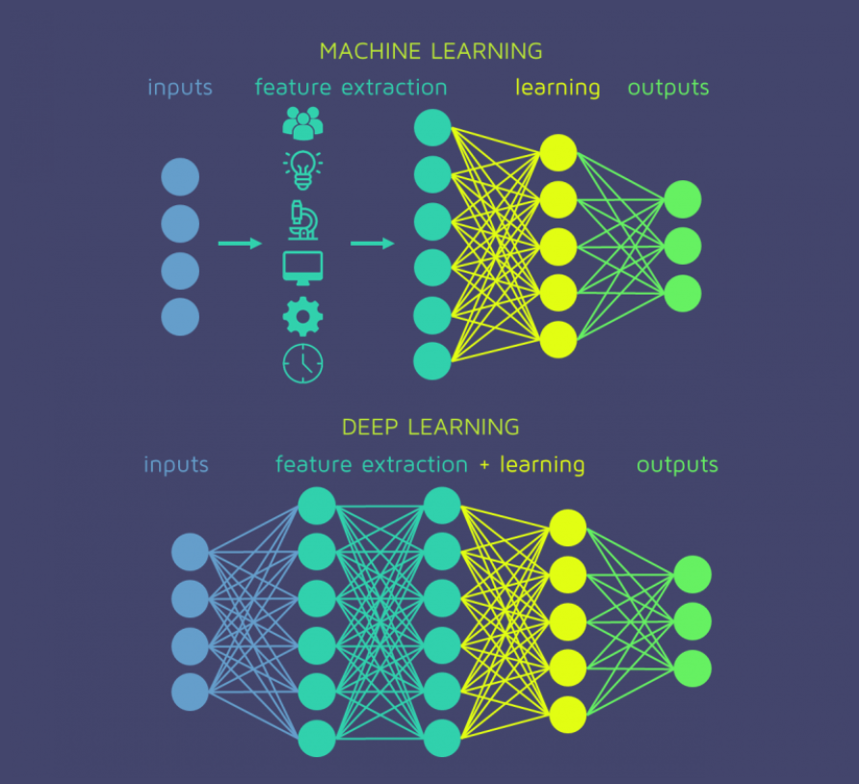
Deep Neural Network
source: https://quantdare.com/what-is-the-difference-between-deep-learning-and-machine-learning/
https://bit.ly/3vIiMlD
@praveenraghuvan

Slide 9
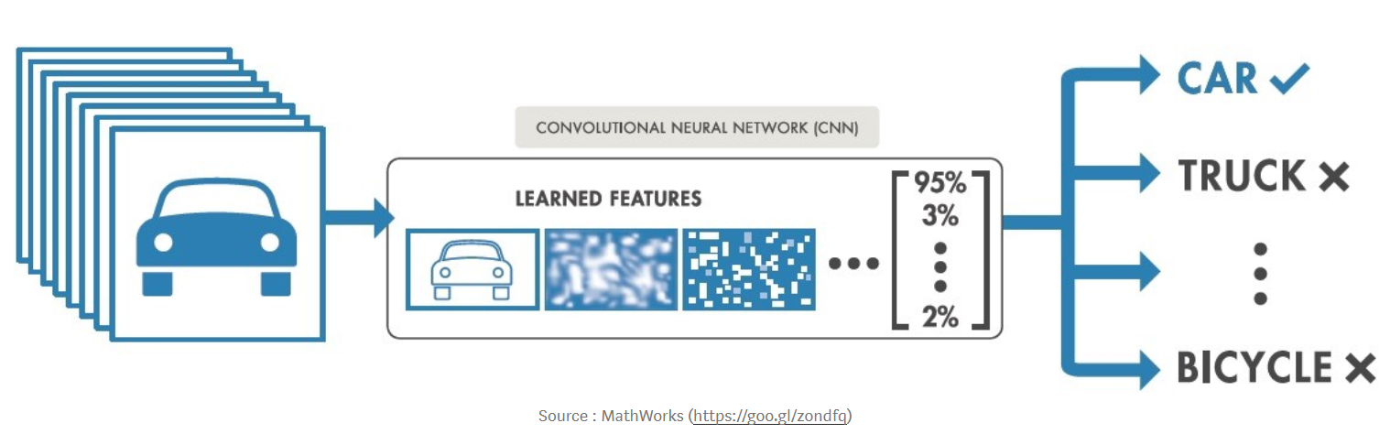
Image Classification
https://bit.ly/3vIiMlD

Slide 10
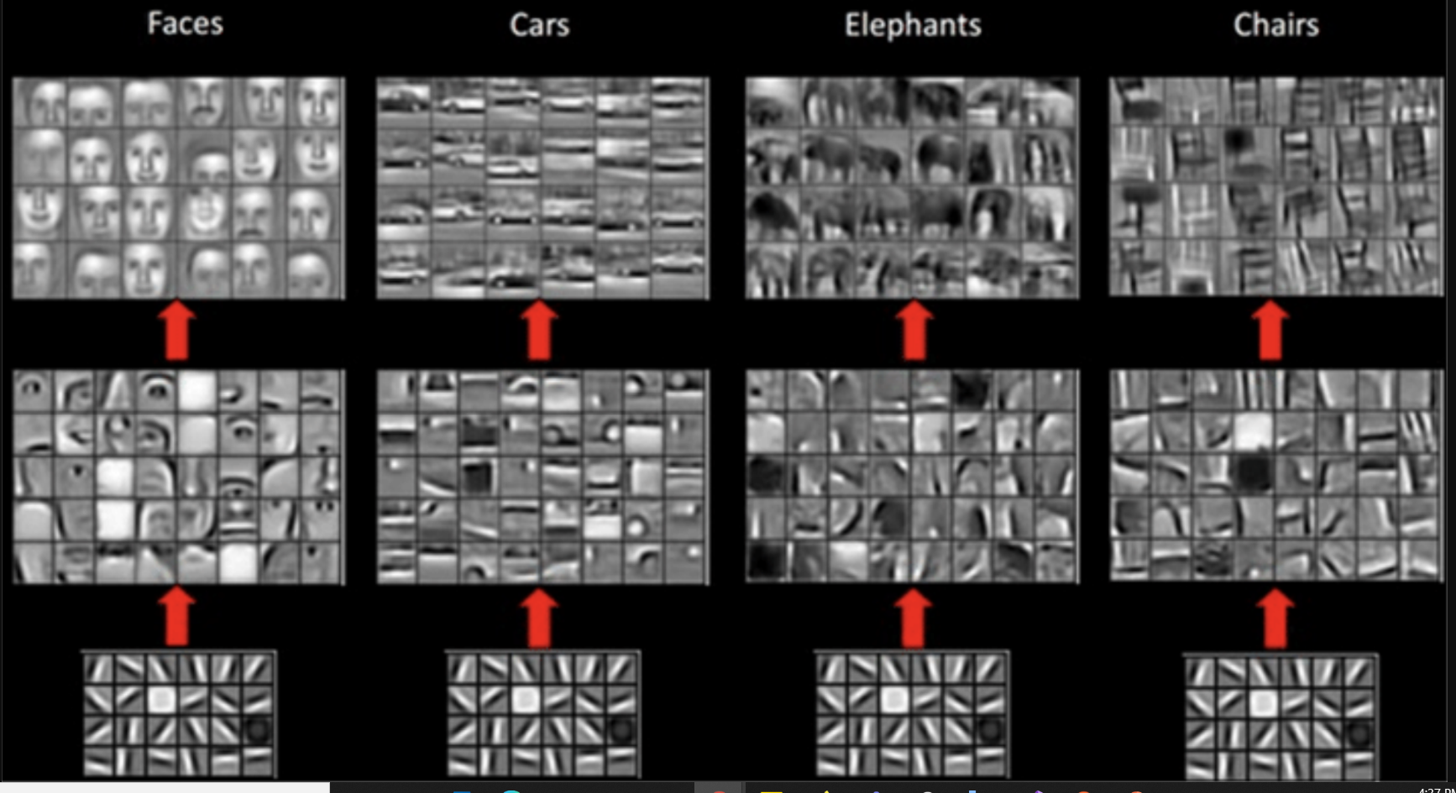
Image Classification
source: https://miro.medium.com/max/1910/1*fLGuAUT5imTIGAeA4zzaWA.png
https://bit.ly/3vIiMlD

Slide 11
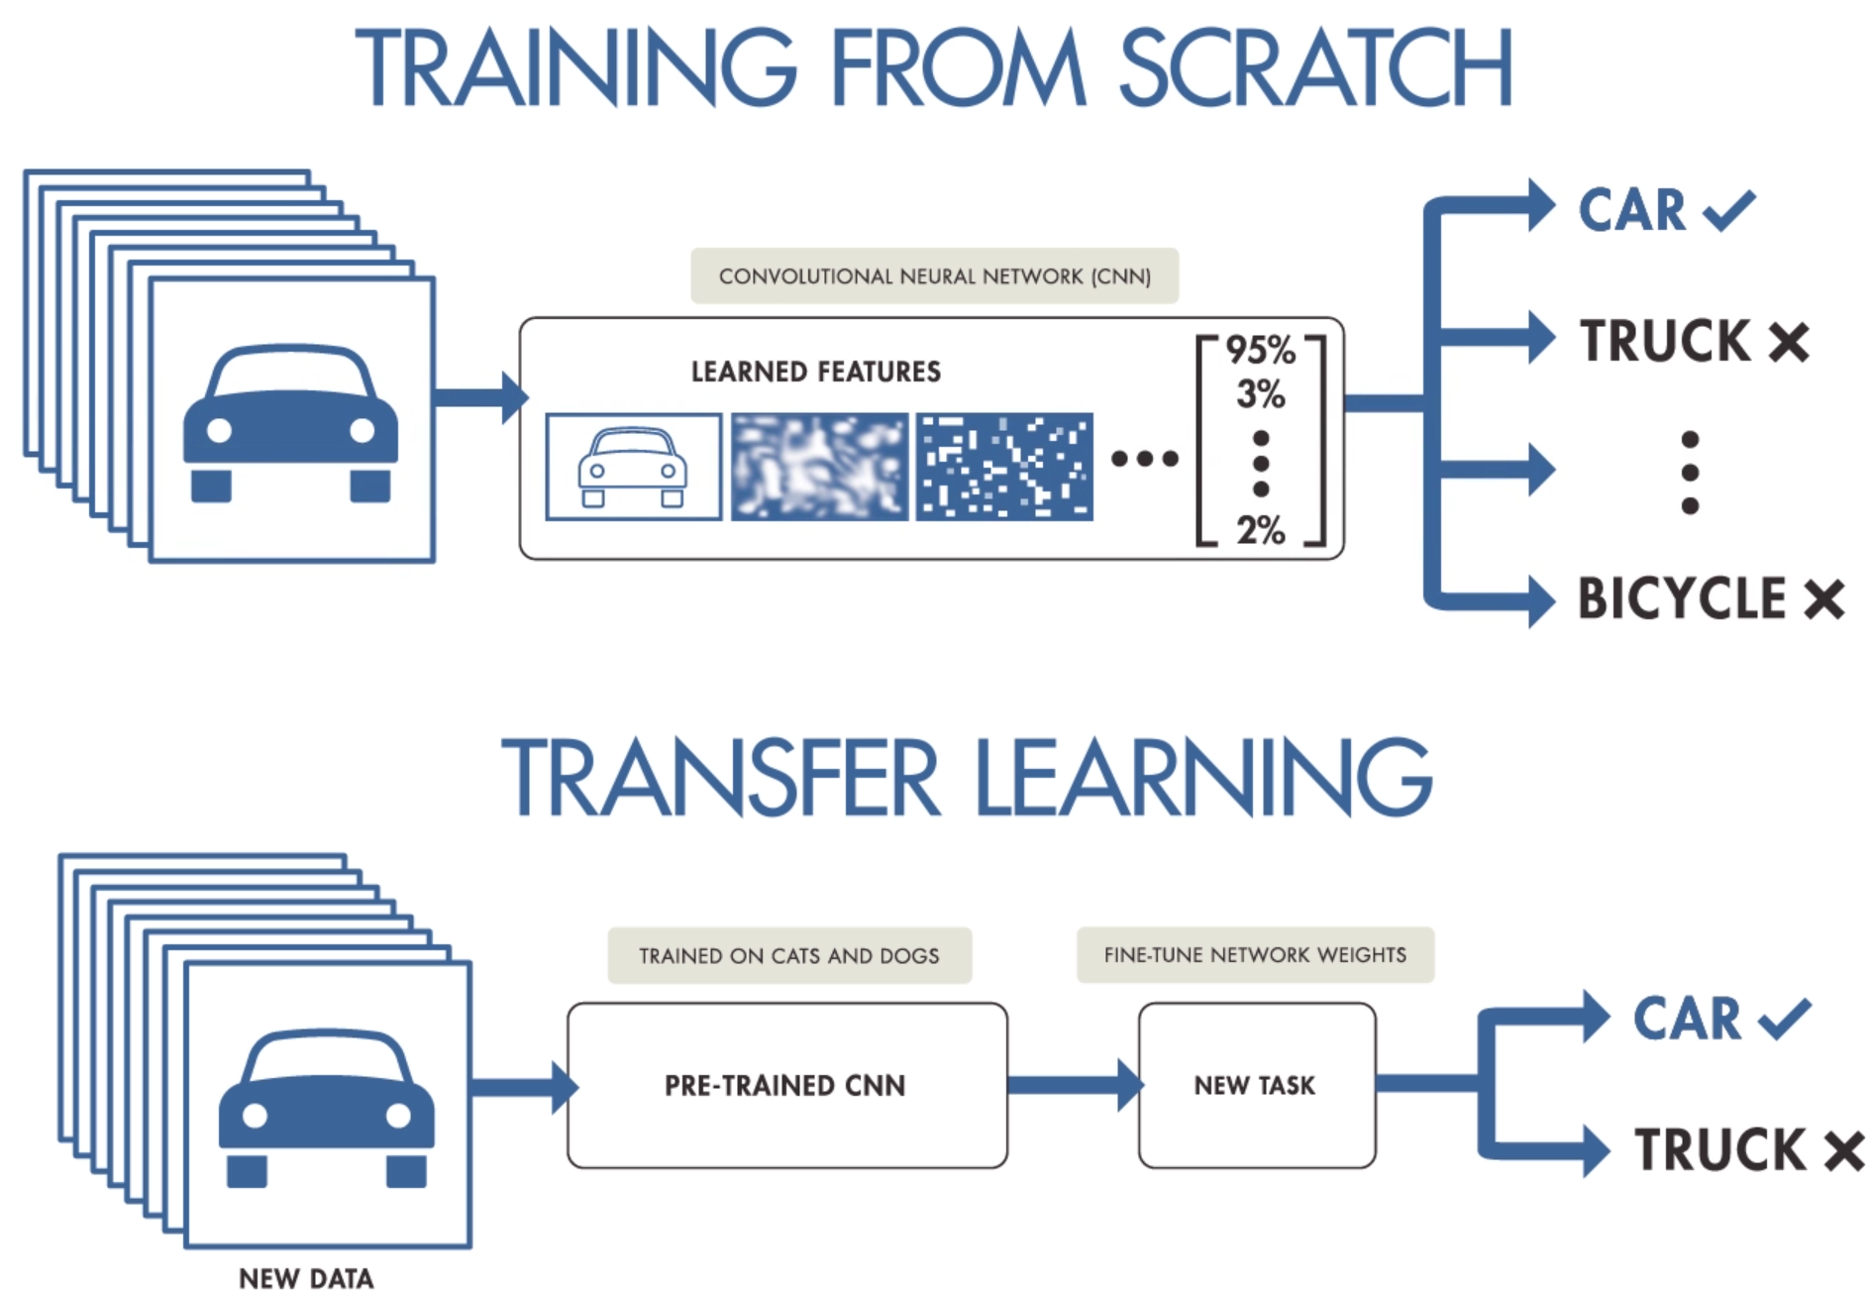
Transfer Learning – MobileNet V2
source: https://i.pinimg.com/originals/0a/76/eb/0a76eb3c95c249cdff9449af08ac4efc.png
https://bit.ly/3vIiMlD

Slide 12
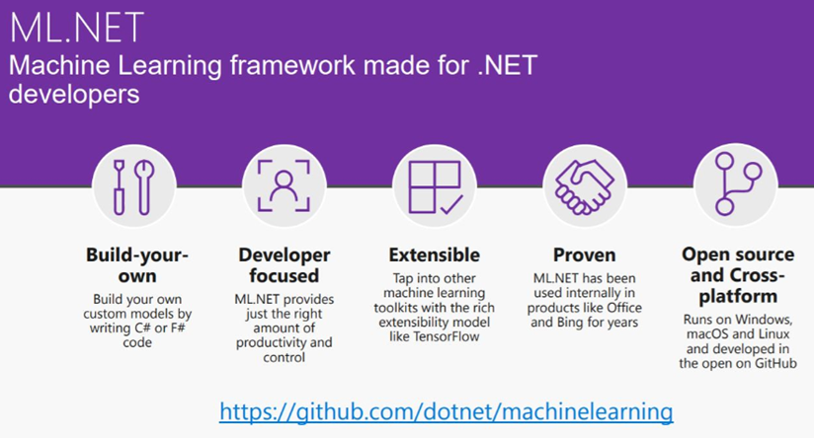
ML.Net
https://bit.ly/3vIiMlD

Slide 13
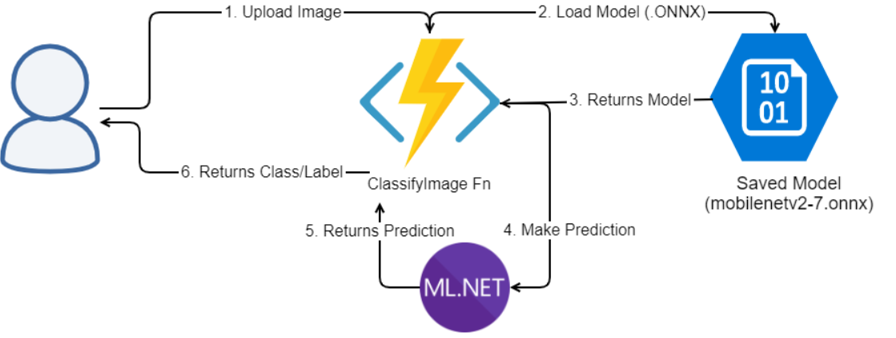
Cloud Architecture
https://bit.ly/3vIiMlD

Slide 14
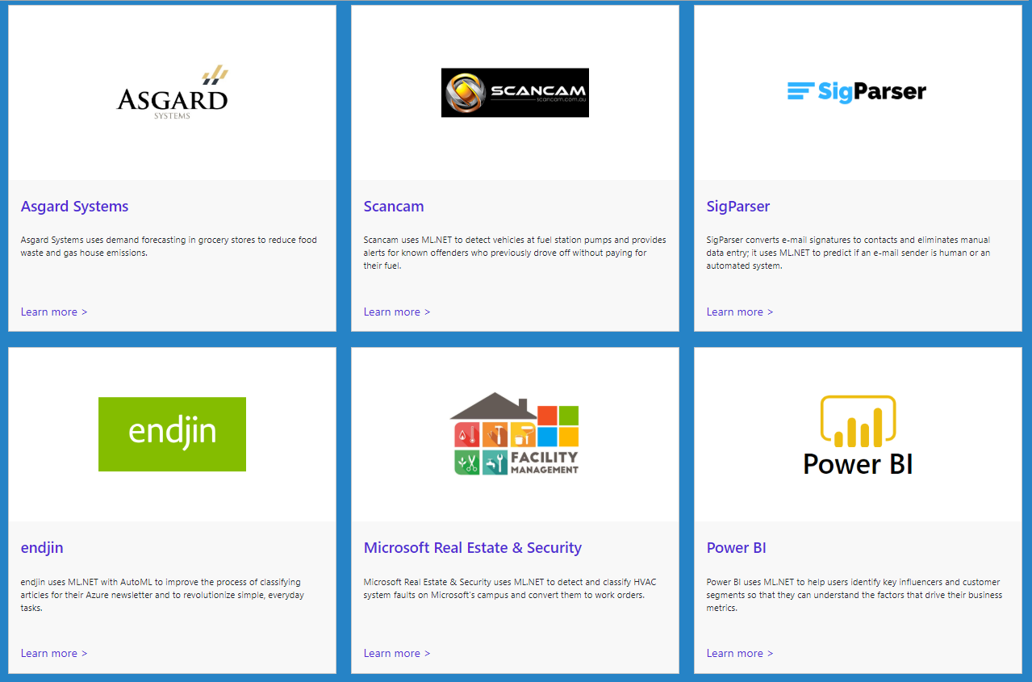
Customer Success Stories – ML.Net
https://dotnet.microsoft.com/apps/machinelearning-ai/ml-dotnet/customers
https://bit.ly/3vIiMlD

Slide 15
Demo
https://bit.ly/3vIiMlD

Slide 16
Resources
Github: https://github.com/praveenraghuvanshi/tech-sessions/blob/master/04052022-CloudLunchAndLearn
Short URL:
https://bit.ly/3vIiMlD
https://bit.ly/3vIiMlD

Slide 17
References
Develop Azure Functions using Visual Studio
Multipart data with Azure Functions HttpTriggers
Tutorial: Train an ML.NET classification model to categorize images
Train a deep learning image classification model with ML.NET and TensorFlow
Tutorial: Detect objects using ONNX in ML.NET
https://bit.ly/3vIiMlD

Slide 18





Thank you Q & A
https://in.linkedin.com/in/praveenraghuvanshi
https://github.com/praveenraghuvanshi
@praveenraghuvan
https://t.me/joinchat/IifUJQ_PuYT757Turx-nLg
https://bit.ly/3vIiMlD

